Slide 1

BIDCAB

Slide 2




Pain Points
Passengers
No Control of Services
Unexplained Ride Cancellations
Lack of transparency with fare calculations & Surge Pricing

Slide 3


Pain Points
Drivers
High Commissions
No Information about the Passenger
No Information about the Route

Slide 4


Riders
Propose desired fare Negotiate with drivers Greater control over pricing
Select drivers based on Rating Vehicle type Estimated arrival time
Real-time Negotiation
Option to Choose
The Solutions for
No-surge multiplier Transparent pricing Consistent fares Elimination of surge pricing Fair and predictable costs
Set tour details Confirm prices Decrease cancellations
No Surge Multiplier
Fewer Cancellations

Slide 5


Drivers
Driver counteroffer pricing Driver's perspective Enhanced flexibility
Select preferred riders Based on criteria Control over rides
Lower commissions at 10% Benefit drivers by increasing their earnings.
Real-time Negotiation
Option to Choose
Lower Commissions
The Solutions for

Slide 6

Application Demo

Slide 7
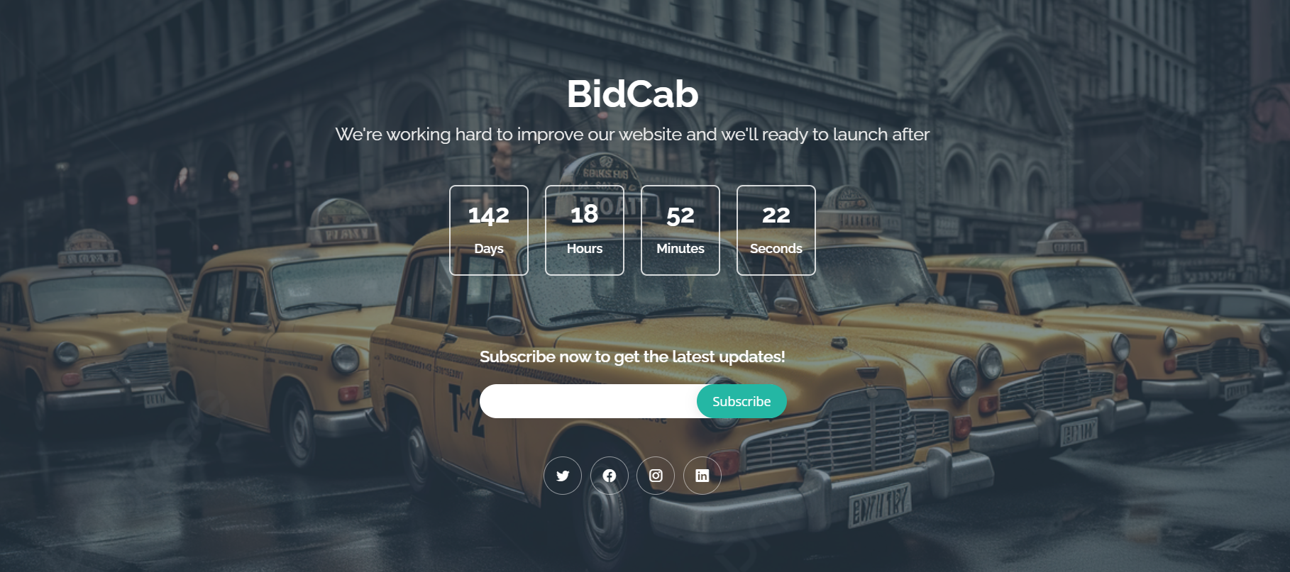
Website Link: BidCab

Slide 8



So Why Now?
1st to the Market
Our ride-hailing app empowers users with greater control and customization. For drivers, we revolutionize the experience by providing autonomy in selecting customers based on price, distance, location, customer rating, and trip time, ensuring a dynamic and efficient platform for both riders and drivers.
Market Shift
Seize the market shift from traditional taxis to ride-hailing services. With traditional taxis declining by 5% and ride-hailing services surging by 9.39%, our app is perfectly positioned to lead the way in this transformative era of transportation
Reliable Mobility
The challenges of frequent strikes and delays in public transport, our ride-hailing app can leverage this situation.

Slide 9
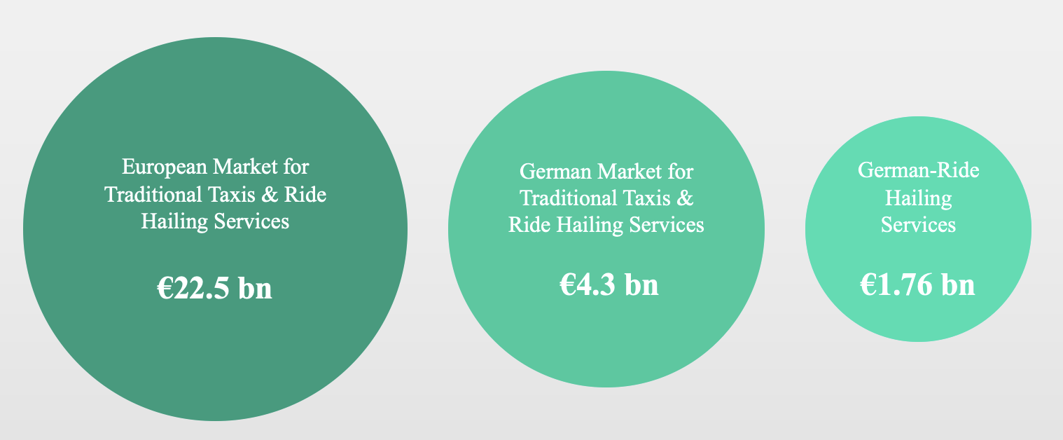
Market Size

Slide 10
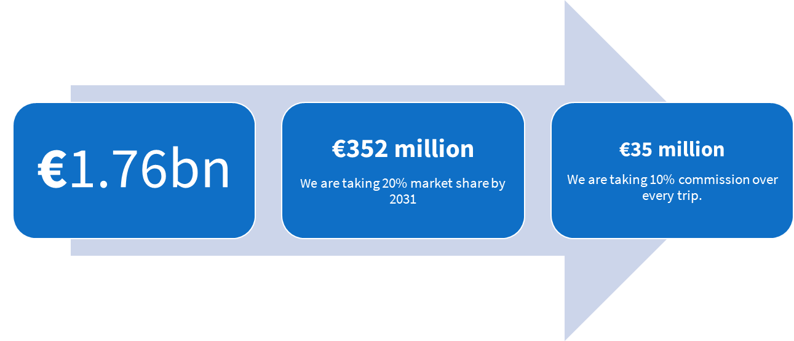
Business Model

Slide 11
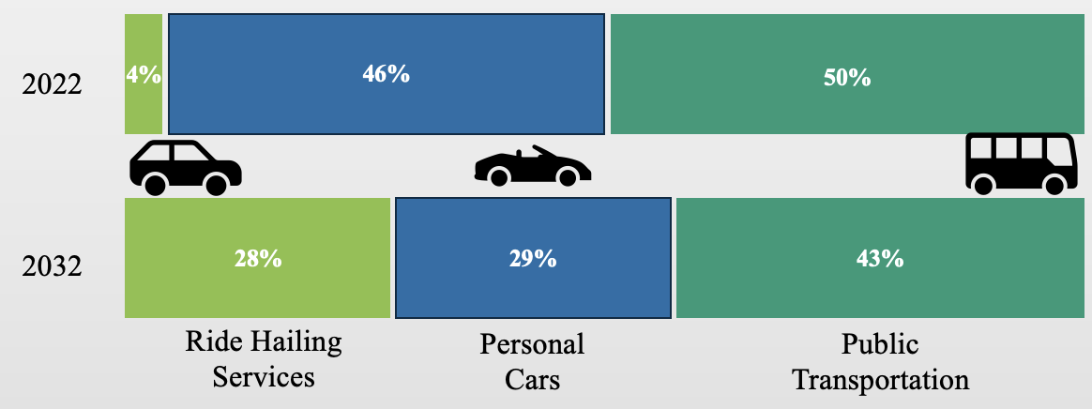

Slide 12









Competitive Advantages
 | The Rider is able to select the cab based on the Car (not just the Category), Time of Arrival, Negotiated Fare, Driver Ratings The Driver is able to select the rider based on the Rider Rating, Negotiated Fare, the Time of Commute, Destination Lowest Commission for the Driver Transfer of Power from the big tech algos to the Rider
 | Considerably lower fares Driver Rating, synonymous to Driver's professionalism and mannerism Rider Rating, synonymous to Rider's behaviour in past rides Visible ETA & Real time tracking Availability of Digital Payments
 | Reliable mobility solution On demand Lower Time of Commute

Slide 13
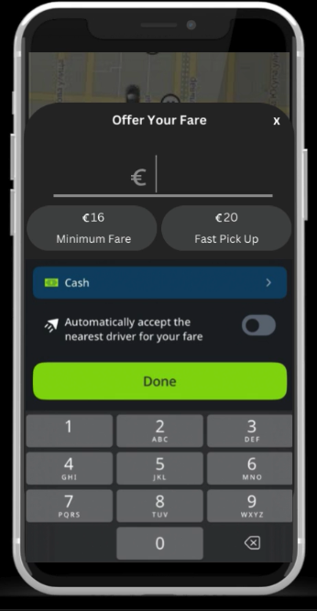
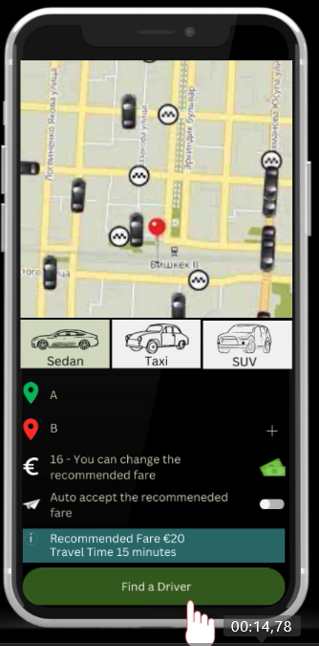
Pricing Model
BidCab offers a personalized pricing model that relies on negotiations between Riders and Drivers.
BidCab provides a suggested price determined by a blend of fixed and variable factors, supported by RLHF and advanced AI technologies.

Slide 14
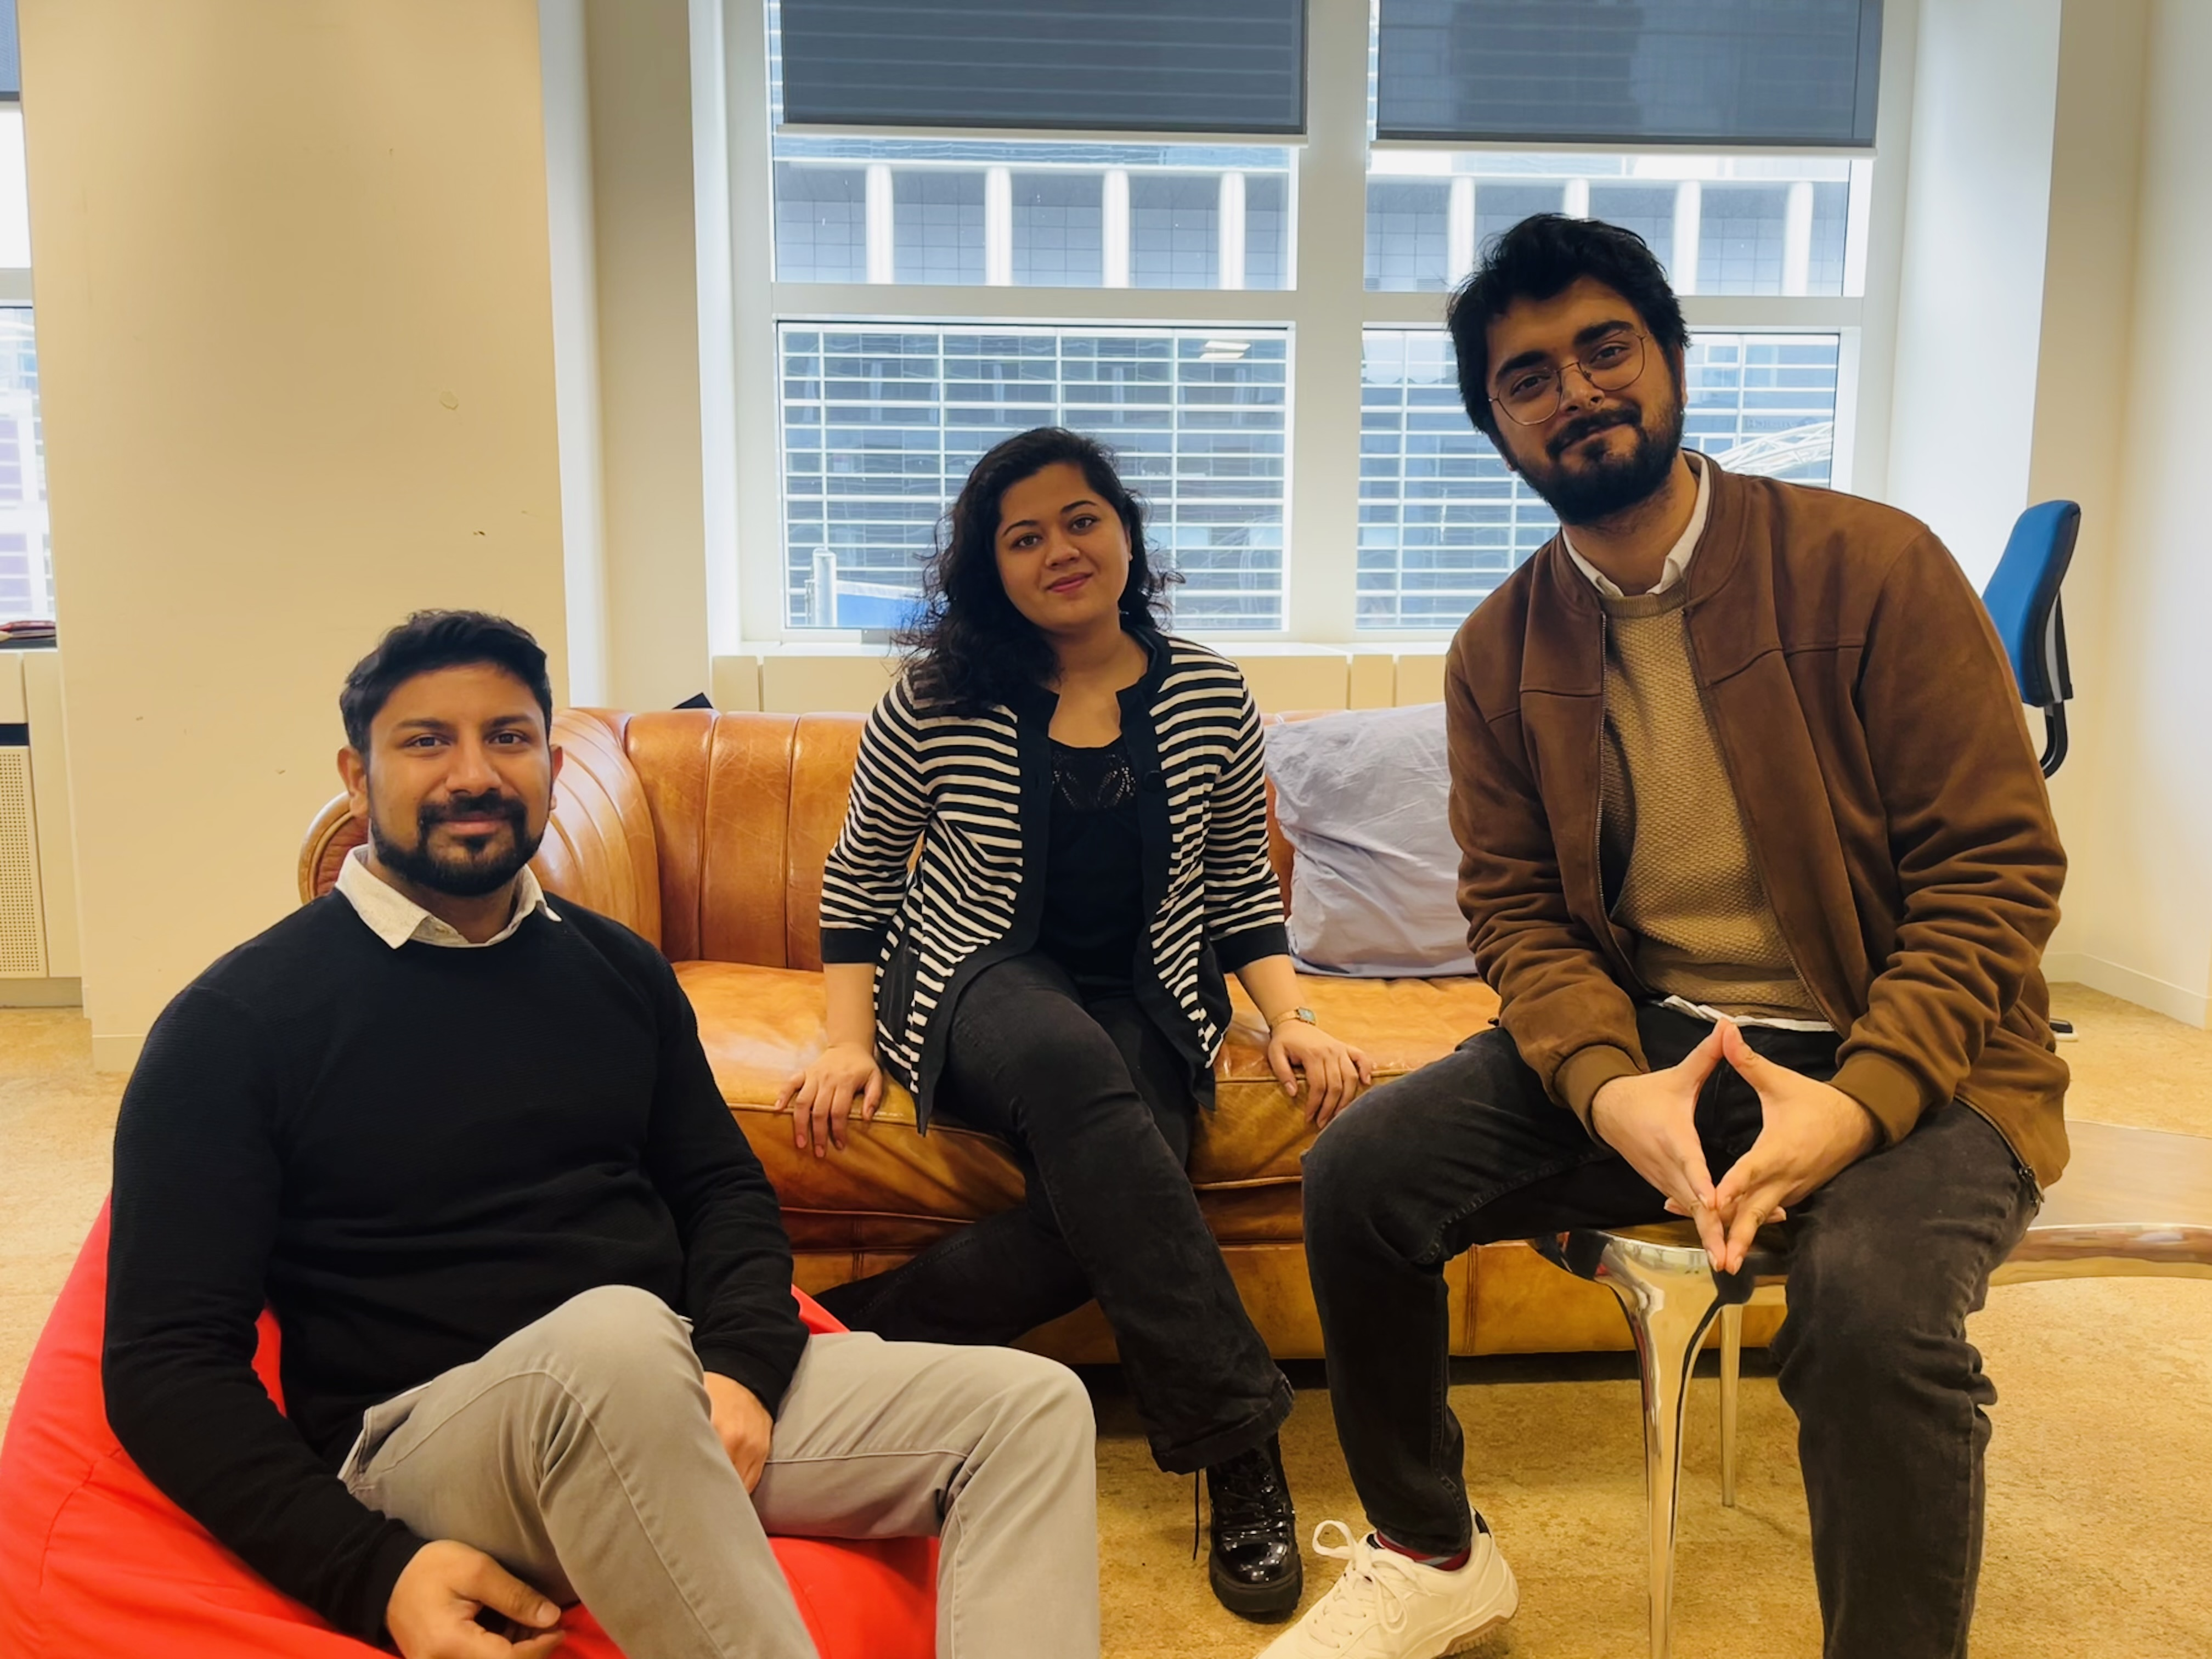

Founders

Slide 15
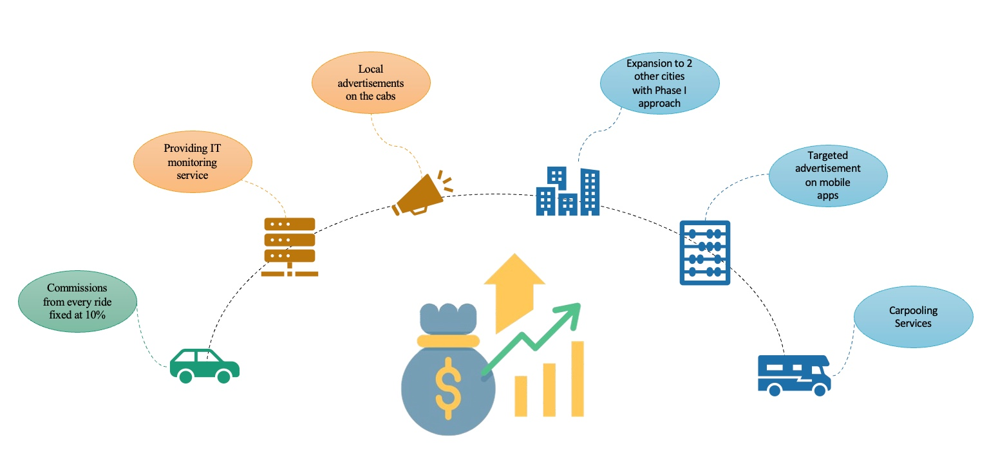
Our Road Map

Slide 16
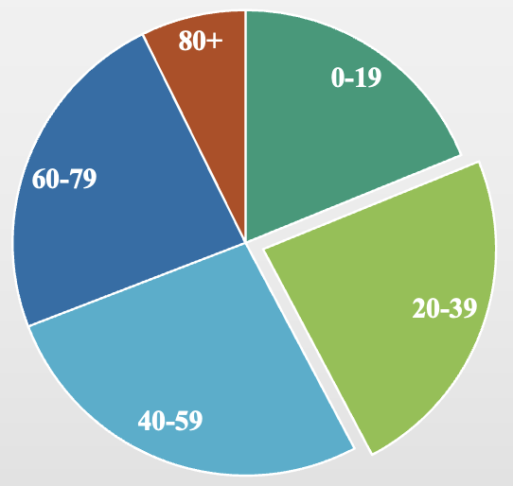


Go to Market- Frankfurt
Population = 658,000
Average Distance of Commute 5KM
€13
20%
225,000
45,000
€585,000
€2.8 mln
10% Commission
4 rides PM
12 months
€28 mln

Slide 17
Our Ask
Marketing Initiatives
Seed Funding
700k
App Development
Team
Expansion

Slide 18


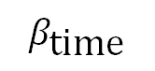
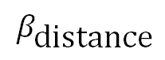
Minimum
Fare
Distance
(in KM)
$$β_{\text{distance}}$$
Time of Commute
(in minutes)
$$β_{\text{time}}$$
Additional Charges (if any)
Base Fare
Base Fare | Determined based on the City of Operation and Type of Car
 | Determined by Reinforcement Learning Model in our Algorithm, based on dynamics of the current situation
Additional Charges | Tolls, Airport Charges etc.
$$β_{\text{distance}}$$
$$β_{\text{time}}$$
BidCab will allow riders to negotiate fares with Drivers directly at or above Minimum Fare.
Driver Performance Monitoring
Static Advertisements
Pricing based on Products Subscribed to by the Local Cab Companies
Can be negotiated between CPM (Cost per Mile) or CPD (Cost per Display)
Car Location & Health Monitoring
Digital Advertisements over screens

Slide 19
(Year 1) €28 mln projected revenue in Frankfurt alone (10% commission model). Strategic discounts to drive user acquisition (10% discounts offered)
Break-even achieved in Year 4 (189 mln revenue, 2.2 mln profit)
The Growth Trajectory (Years 2-5): Aggressive year-over-year revenue growth (1.5x).
Continued market dominance in Year 5 (283 mln revenue, 3.5 mln profit)
Expansion to two new cities by Year 3 (126 mln revenue)
Our Ask
500k Euro
€500,000 seed funding to propel our app development, marketing initiatives, and team expansion.

